Slide 1
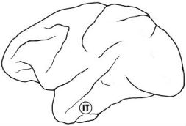
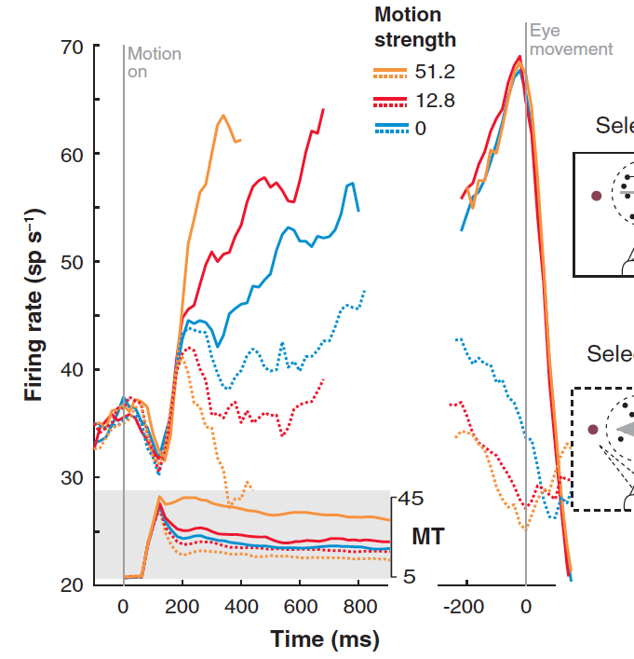
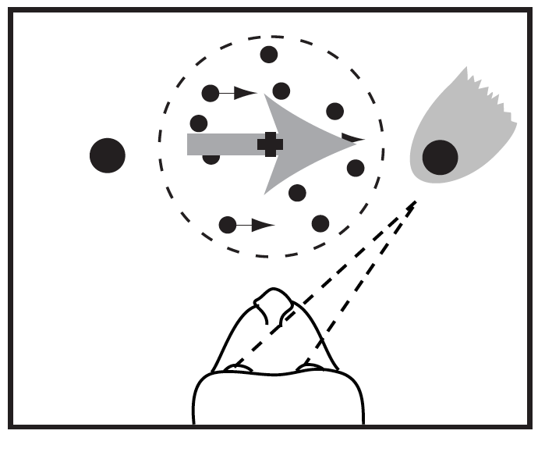
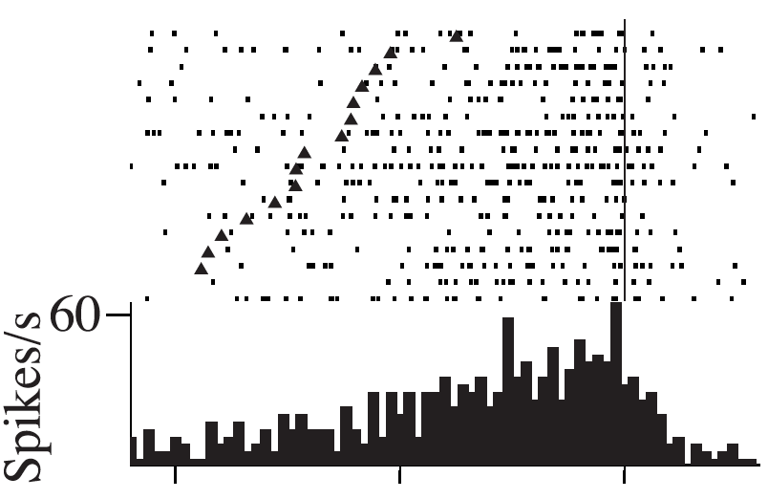
Evidence accumulation in cortical circuits
LIP
stim. onset
-1000 -500 0
Time from response (s)
Roitman & Shadlen et al 1996

Slide 2
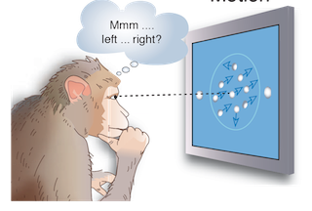
Perceptual decisions: a motion discrimination task
Britten, Newsome, Shadlen, Celebrini and Movshon. 1996

